Slide 1

COURSE: DATA SCINECE TOPIC: PANDAS iNSTRUCTOR: REEMA MEMON

Slide 2
INTRODUCTION TO PANDAS:
Pandas is a powerful and popular open-source data manipulation and analysis library for the Python programming language.
It provides easy-to-use data structures and data analysis tools, making it a valuable tool for data scientists, analysts, and developers working with structured data, making it easier to clean, transform, and analyze datasets.
Pandas was created by Wes McKinney, a data scientist and software developer.

Slide 3
Key Features of Pandas:
1. Data Structures:
- Series: A one-dimensional array-like object.
- DataFrame: A two-dimensional, tabular structure with labeled axes (rows and columns).
2. Data Cleaning and Transformation:
- Handling missing values, filtering data, combining datasets.
3. Input and Output (I/O):
- Supports reading and writing data in various formats such as CSV, Excel, SQL, JSON.
4. Efficient Data Operations:
- Vectorized operations using NumPy, grouping and aggregating data.
5. Time Series Data:
- Support for time-indexed data.
6. Data Visualization:
- Integration with Matplotlib and Seaborn libraries.

Slide 4
What are Series and Dataframe?
Series:
A Pandas Series is like a column in a table.
It is a one-dimensional array holding data of any type.
Dataframe:
A Pandas DataFrame is a 2 dimensional data structure, like a 2 dimensional array, or a table with rows and columns.

Slide 5
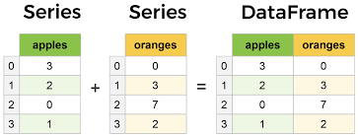
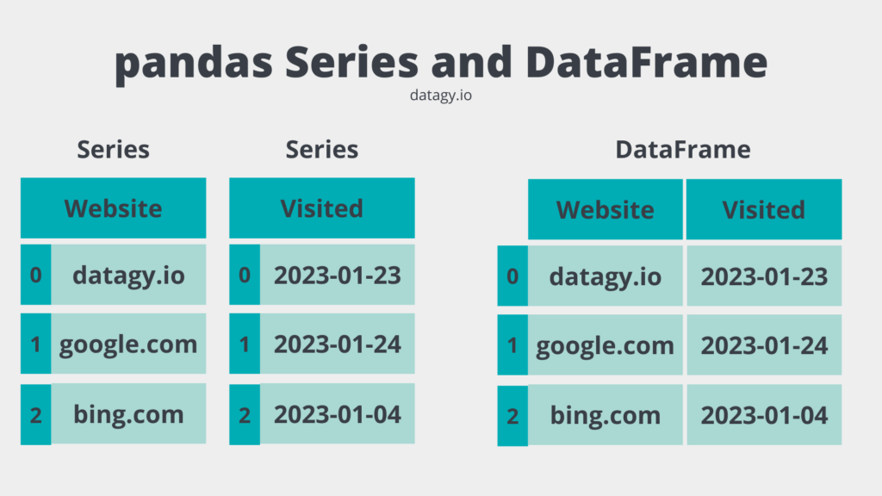

Slide 6
Python Series:
import pandas as pd
s=pd.Series([1,2,3,4,5])
print(s)
type(s)
You can also print the elements one by one using the index.
print(s[1])
With the index argument, you can name your own labels.
s=pd.Series([1,2,3], index=[‘x’,’y’,’z’])
print(s)

Slide 7
Key/Value Objects as Series
You can also use a key/value object, like a dictionary, when creating a Series.
import pandas as pd
runs = {"day1": 480, "day2": 380, "day3": 390}
s = pd.Series(runs)
print(s)

Slide 8
DataFrame:
Using dictionary:
import pandas as pd
dict1= {"Student Name":[“Ahmed", "Ali", "Faraz"], "Marks":[88,89,90]}
df=pd.DataFrame(dict1)
df
Saving the file as csv and excel:
df.to_csv(‘abc.csv’, index=False)

Slide 9
Reading a csv and excel file:
df=pd.read_excel(‘filename.xlsx')
df=pd.read_csv(‘filename.csv')
Reading the first n rows:
df.head(n) : where n specifies the number of rows
Reading the last n rows:
df.tail(n) : where n specifies the number of rows

Slide 10
Retrieving the column names:
df.keys()
Changing the index of the dataframe:
df.index=["First", "Second", "Third", "Fourth", "Fifth", "Sixth", "Seventh", "Eighth", "Ninth", "Tenth"]
Changing a entry of a column:
df[‘column_name’][index]=“Your specified entry”
Specifying the datatype of the columns
df.dtypes

Slide 11
Transposing the data frame:
df.T
Lets do it!
Create an excel file of 10 rows and 5 columns, in the columns write student names and in the rows enter numerical data.
Checking the shape of the data:
df.shape

Slide 12
Pandas’s describe() method provides descriptive statistics of a DataFrame or a specific column. By default, it calculates statistics for numerical columns, including count, mean, standard deviation, minimum value, 25th percentile (Q1), median (50th percentile or Q2), 75th percentile (Q3), and maximum value.
df.describe()
If you want to include non-numeric columns in the statistics, you can use the include='all' parameter.
df.describe(include='all').

Slide 13
Sorting the data by index:
df.sort_index(axis=0) #By default, the sorting parameter is ascending or you can say ascending=True
Try these out:
df.sort_index(axis=0, ascending=False)
df.sort_index(axis=1)
df.sort_index(axis=1, ascending=True)

Slide 14
newdf=a #newdf will point a, it will not copy
Changing newdf will also change a
#To create a copy of a dataframe we have to use the copy function
newdf=a.copy()
df.loc: #The df.loc method is used access, update or set values of specific rows and columns in a DataFrame.
For example, df.loc[row_label, column_label] = new_value.

Slide 15
Try this out:
df.loc[:,[‘Column 1’, ‘Column 2’]]
You can also try using all the columns and only specific rows.
You can also select multiple number of rows and columns.
df.loc[[row1,row2], [‘column1, column2]]

Slide 16
One can also specify different conditions using df.loc method.
df.loc[(df[‘Column Name1’]>a) & (df[‘Column Name2’]>b)]
Where a and be can be any numbers, just like checking conditions for if-else.
Now we will learn about df.iloc.

Slide 17
loc is a label-based method that can be used to select rows and columns by their labels or boolean arrays.
df.loc[row_selection, column_selection]
iloc is an integer-based method that can be used to select rows and columns by their integer index.
df.iloc[row_index, column_index]
df.iloc[0,3] : Try this out

Slide 18
Pandas - Cleaning Empty Cells:
Removing Rows: One approach to handling empty cells in a dataset is to remove the entire rows that contain those empty cells. This means that if any cell in a row is empty or contains missing data, the entire row is dropped from the dataset.
df.dropna()
By default, the dropna() method returns a new DataFrame, and will not change the original.
If you want to change the original DataFrame, use the inplace = True argument.
df.dropna(inplace=True)

Slide 19
The inplace argument:
It is a parameter in pandas functions that specifies whether the operation should modify the original object (DataFrame, Series, etc.) in place or return a new object with the desired changes.
Another way of dealing with empty cells is to insert a new value instead.
This way you do not have to delete entire rows just because of some empty cells.
The fillna() method allows us to replace empty cells with a value:

Slide 20
df.fillna(anynumber, inplace=True)
Replace Only For Specified Columns:
To only replace empty values for one column, specify the column name for the DataFrame.
df[‘Column Name’].fillna(anynymber, inplace=True)
Discovering Duplicates:
Duplicate rows are rows that have been registered more than one time.
To discover duplicates, we can use the duplicated() method.
The duplicated() method returns a Boolean values for each row:

Slide 21
df.duplicated() = True #It means there are duplicate rows available in the dataset.
df.duplicated()=False #It means there are no duplicate rows in the dataset.
If you want to remove the duplicated rows you can use:
df.drop_duplicates(inplace=True)
The (inplace = True) will make sure that the method does NOT return a new DataFrame, but it will remove all duplicates from the original DataFrame.

Slide 22
The df.isnull() function in pandas is used to check for missing or null values in a DataFrame.
df.isnull()
Finding Correlation:
The corr() method calculates the relationship between each column in your data set.
The correlation of a column with itself will always be equal to 1.

Slide 23
Find mean, median, mode using the following methods.
df.mean()
df.median()
df.mode()

Slide 24
Please note, that there are a lot of methods and functions in Pandas, explore it yourself, do the analysis of datasets by importing them from Kaggle. Keep exploring and learning.
ANY QUESTIONS?

